Slide 1
Human Computation / Foldit
Presented by:
Jiwei Li
Ratish Malhotra
Paul Munn

Slide 2
What is Human Computation?
There are many tasks that humans are well suited to, that are very hard or impossible (currently) for computer programs.
Human computation is a type of collaborative intelligence combined with crowdsourcing

Slide 3
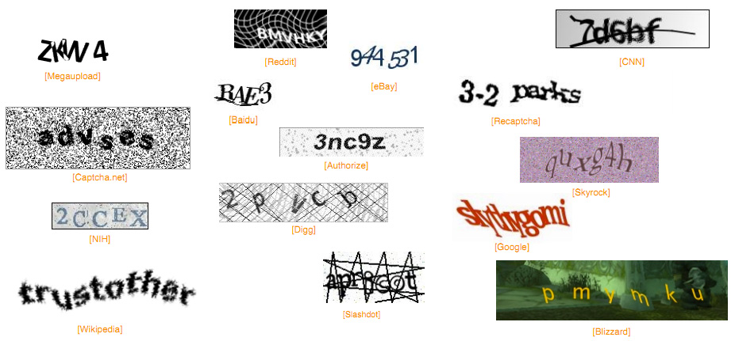
CAPTCHA
Completely Automated Public Turing test to tell Computers and Humans Apart

Slide 4
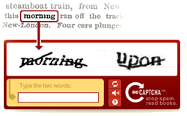
RE-CAPTCHA
Approx 200 million CAPTCHAs typed every day (over 500,000 hours)
Luis von Ahn (Carnegie Mellon)
http://www.ted.com/talks/luis_von_ahn_massive_scale_online_collaboration.html
Duolingo (learn a new language while translating the web)
The ESP game (labeling images with a computer game)
http://www.cs.cmu.edu/~biglou/ESP.pdf

Slide 5
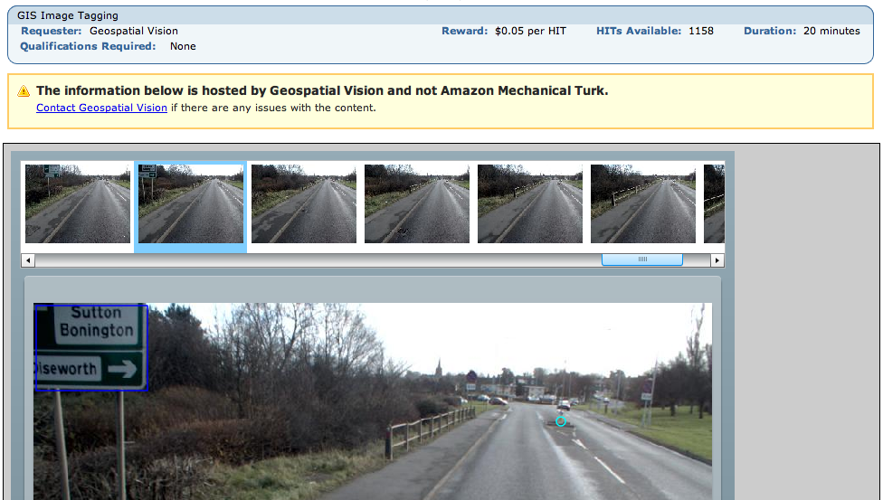
Mechanical Turk
You are paid 5 cents to tag 50 images with yellow lines, manholes, drains, bollards and pedestrian crossings

Slide 6
Other Examples
Training activity recognition systems
http://www-vizwiz.cs.rochester.edu/pubs/pdfs/crowdar_ubicomp.pdf
YouTube Lens: Personality Impressions and Audiovisual Analysis of Vlogs
http://ieeexplore.ieee.org/xpl/login.jsp?tp=&arnumber=6331531&url=http%3A%2F%2Fieeexplore.ieee.org%2Fxpls%2Fabs_all.jsp%3Farnumber%3D6331531
Aiding of quest design in games
http://ieeexplore.ieee.org/xpl/articleDetails.jsp?reload=true&arnumber=6354760&contentType=Conference+Publications

Slide 7
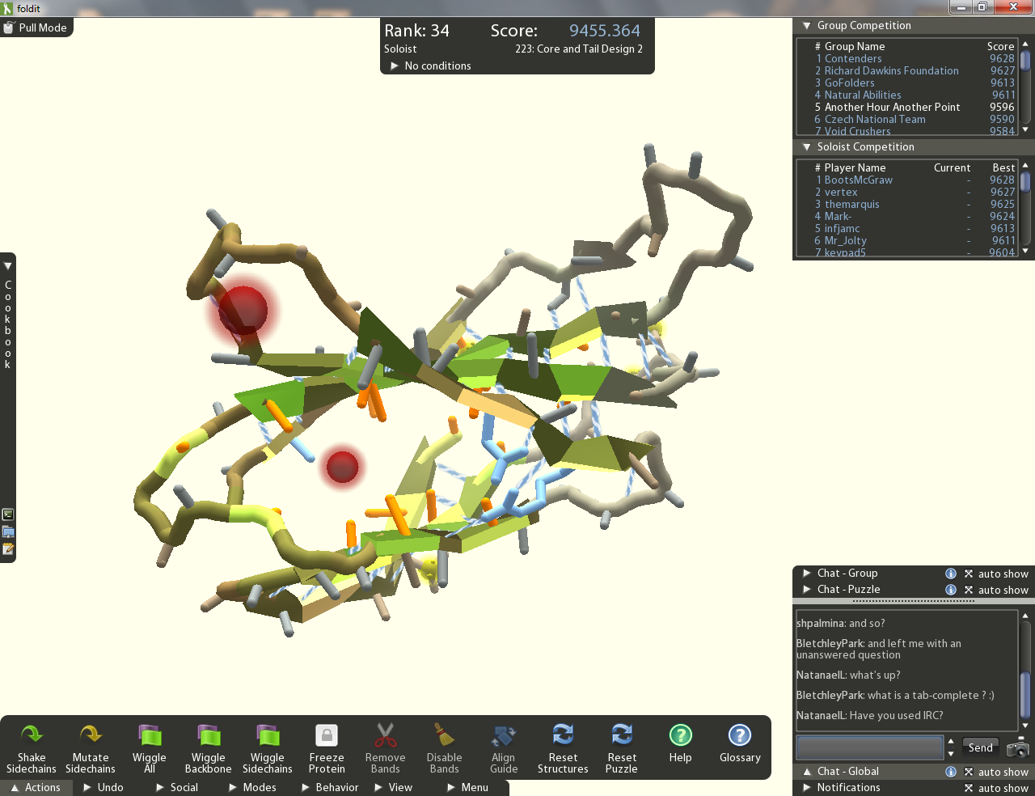
Foldit is Different
The first crowdsourced attempt to develop algorithms to solve a complex scientific problem
It uses ‘game design’ techniques that leverage people’s natural desire for competition, achievement, status, self-expression, altruism and closure

Slide 8
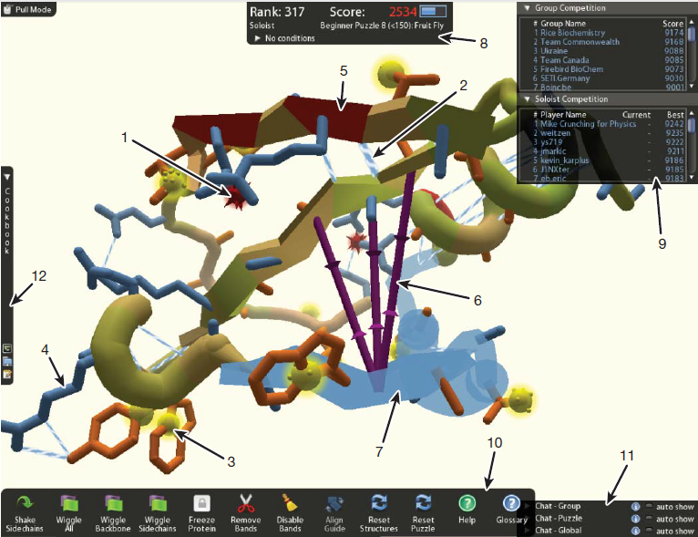
Predicting protein structures with a multiplayer online game
5 August, 2010. Nature

Slide 9
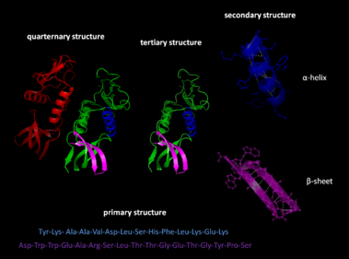
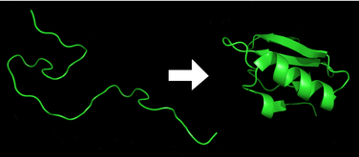
Protein Folding
Protein folding is the process by which a protein structure assumes its functional shape or conformation
Amino Acid -> Peptide -> Secondary Structure (Alpha helix or Beta sheet) -> Tertiary Structure(Protein Domain) -> Quaternary Structure

Slide 10
Task: Protein Structure Prediction
Amino Acid Sequence, Conformational Structure, Peptide Sequence …
Challenge in Computing: So many degrees of freedom

Slide 11
Why Crowd-Source Protein Folding Computation?
The most accurate way of finding the protein structure is crystallography, which is expensive, tedious, and slow
Homologous structures are an efficient way but we do not have homologues for all proteins
Brute-force computation and other simple algorithms take too much time and are too computationally complex
Humans can do spatial reasoning that can be much more difficult computers with ease
Combination of so many people leads to larger and increased computational and brain power

Slide 12
Rosetta uses a combination of stochastic and deterministic algorithms
Stochastic
Random perturbation to a subset of the backbone torsion angles.
Deterministic
Combinatorial optimization of protein side-chain conformations.
Gradient-based energy minimization.
Energy-dependent acceptance or rejection of structure changes.

Slide 13
Foldit
They hypothesized that human spatial reasoning could improve the determination.
The stochastic elements of the search are replaced with human decision making while retaining the deterministic Rosetta algorithms as user tools

Slide 14
Foldit
Online “multiplayer” puzzle video game about protein folding
Immense computational problem relevant to Bioinformatics, Molecular Biology, and Medicine
Protein structure gives way to manufacturing drugs with exact target receptors in curing diseases
The problem is essentially crowd-sourced to more efficiently and accurately create algorithms for the solving the protein structure
Players manipulate protein structure to find the lowest energy state
Players create and share algorithms that then evolve to most efficiently and accurately come up with a structure

Slide 15
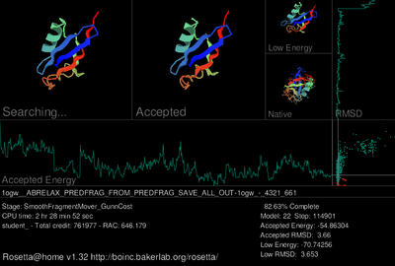
History of Foldit
Original algorithmic framework came from Rosetta, created by David Baker of the University of Washington’s Department of Biochemistry
Rosetta also had a similar tool as Foldit called Rosetta@home, the purpose of which was to create algorithms via a large collaborative effort
Rosetta was subsequently developed into a game, Foldit, with the collaboration of UW’s Biochemistry and Computer Science departments to make it more appealing to the common audience
http://www.youtube.com/watch?v=GzATbET3g54

Slide 16
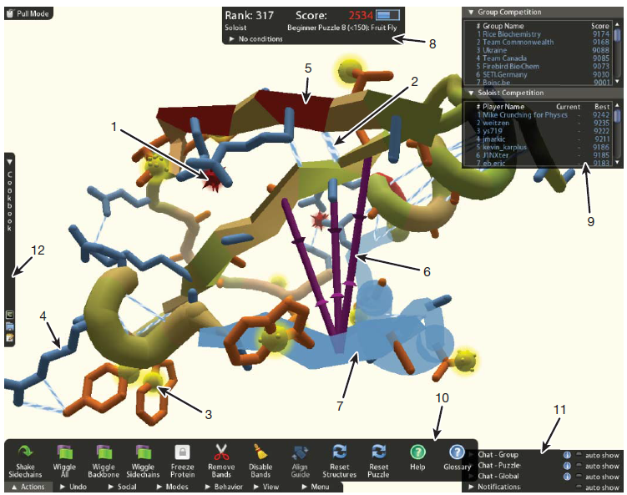
Notes:
Background knowledge usage.We remove protein elements that hinder structural problem solving, and highlight energetically frustrated areas of the protein where the player can probably improve the structure

Slide 17
Examples of blind structure prediction
Native structures are shown in blue, starting puzzles in red, and top-scoring Foldit predictions in green
Notes:
The red starting puzzle had a register shift and the top-scoring green Foldit prediction correctly flips and slides the beta-strand. b, On the same structure as above, Foldit players correctly buried an exposed isoleucine residue in the loop on the bottom right by remodelling the loop backbone. c, The top-scoring Foldit prediction correctly rotated an entire helix that was
misplaced in the starting puzzle. d, The starting puzzle had an exposed isoleucine and phenylalanine on the top, as well as an exposed valine on the bottom left. The top-scoring Foldit prediction was able to correctly bury
these exposed hydrophobic residues

Slide 18
Advantages
Human players are also able to distinguish which starting point will be most useful to them.
Players were also able to restructure b-sheets to improve hydrophobic burial and hydrogen bond quality. Automated methods have difficulty performing major protein restructuring operations to change b-sheet hydrogen-bond patterns, especially once the solution has settled in a local low-energy basin

Slide 19
Recipes
Purpose of the game is to solve protein structure either by creating or using pre-made "recipes," which is essentially an automated strategy that uses certain algorithms encompassed in tools in a certain sequential order.
Creators of recipes can chose to designate their recipes either public or private.
During the three and a half month study period, 721 Foldit players ran 5,488 unique recipes 158,682 times and 568 players wrote 5,202 recipes.

Slide 20
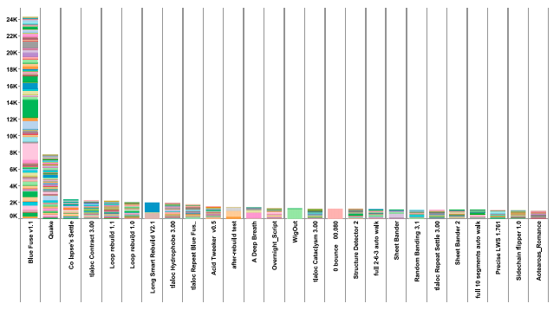
Recipe Frequency
Unsurprisingly, recipe frequency was heavily correlated with if the author decided to make his or her recipe public or private
Certain recipes became a lot more popular than others by word of mouth, as players would recommend a certain algorithm to others
The reputation of the author also played a part

Slide 21
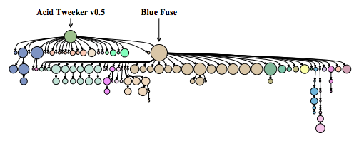
Recipe Evolution
Good and popular recipes would be selected for in the evolution of recipes
Lesser known or poor recipes would quickly die out because not enough people would use them
Players then would build on the already good and popular recipes creating progeny of those algorithms by introducing some variation

Slide 22
List of Recipe Types and Tools
The recipes created pre-dominantly fell into four main categories:
Perturb and Minimize
Aggressive Rebuilding
Local Optimize
Set Constraints
Several tools available in creating algorithms and coming up with a structure
Freeze
Rebuild
Rubber bands
Alignment Tool
Tweak
Wiggle
Shake sidechains
Notes:
jknekjrnfe

Slide 23
Recipe Types
Perturb and Minimize
Goes beyond the deterministic minimize function provided to Foldit players
Disadvantage of readily being trapped in local minima
Perturbations are added that lead the minimizer in different directions
Aggressive Rebuilding
Uses the rebuild tool which performs fragment insertion to search different areas of conformation space of the protein
Often run for long periods of time as they are designed to rebuild entire regions of a protein rather than just refining them

Slide 24
Recipe Types (cont.)
Local Optimize
Performs local minimizations along the protein backbone in order to improve the Rosetta energy for every segment of a protein
Set Constraints
Does either of the following two tasks:
Assigns constraints between beta strands or pairs of residues (rubber bands)
Changes the secondary structure assignment to guide subsequent optimization

Slide 25
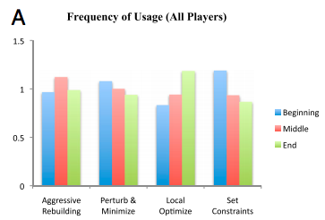
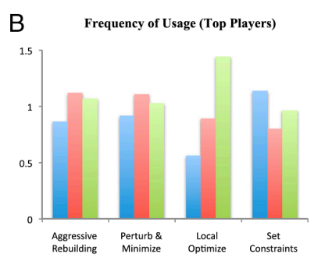
Frequency of Recipe Types
Beginning
Both groups rely on Set Constraints the most
Distribution is about the same
Middle
Perturb and Minimize are the most used in both groups
Top players use it more often
End
Local Optimize is the dominant strategy in both groups but top players favor it more

Slide 26
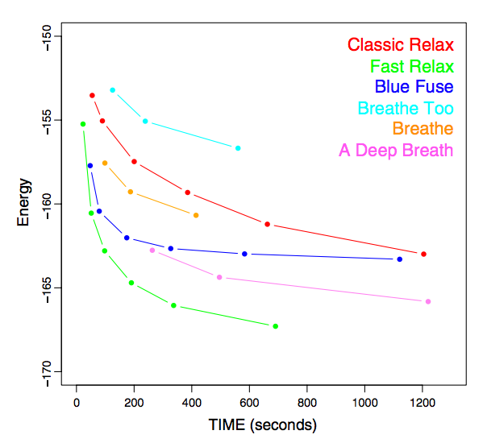
Performance Comparison
Foldit Recipes: A Deep Breath, Breath Too, Breathe, and Blue Fuse
Rosetta Recipes: Classic Relax and Fast Relax
Blue Fuse is one of the most popular recipes in Foldit
Blue Fuse outperformed Classic Relax and was found to be structurally similar to Fast Relax

Slide 27
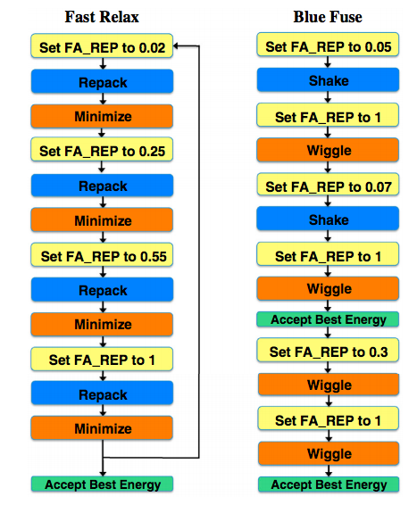
Blue Fuse vs. Fast Relax
Structurally similar
Fast Relax is better because it can go through multiple cycles itself
Blue Fuse requires for humans to make it go through another cycle

Slide 28
So Where is All This Going?
Future directions for Foldit
Develop better algorithms for automating the process
Demonstrated the potential for creation and formalization of complex problem-solving strategies
The approach should be readily extendable to related problems, such as protein design and other scientific domains where human three-dimensional structural problem solving can be used.
What future systems will need to look like
Possible future applications
Oil reserve location (already used to find gold deposits)
SETI (perhaps?)

Slide 29
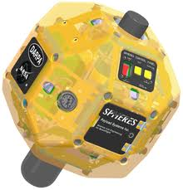
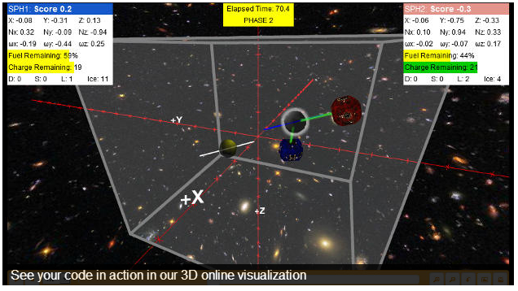
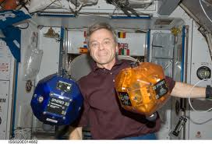
SPHERES Zero Robotics
DARPA’s InSPIRE program is using crowdsourcing to develop spaceflight software for small satellites.
Allowing thousands of amateur participants to program using the SPHERES simulator and eventually test their algorithms in the microgravity of the ISS.
http://www.zerorobotics.org/web/zero-robotics/home-public

Slide 30
Ethical Considerations
Internet-based crowdsourcing and research ethics: the case for IRB review (Mark A Graber, Abraham Graber)
http://www.ncbi.nlm.nih.gov/pubmed/23204319
Abstract:
The recent success of Foldit in determining the structure of the Mason-Pfizer monkey virus (M-PMV) retroviral protease is suggestive of the power-solving potential of internet-facilitated game-like crowdsourcing. This research model is highly novel, however, and thus, deserves careful consideration of potential ethical issues. In this paper, we will demonstrate that the crowdsourcing model of research has the potential to cause harm to participants, manipulates the participant into continued participation, and uses participants as experimental subjects. We conclude that protocols relying on this model require institutional review board (IRB) scrutiny.

